Slide 1
Hacking Microsoft Teams
Paul Keijzers
#SPSMAD
Notes:
This slide is mandatory. Please do not remove.

Slide 2

Paul Keijzers (MVP)
Developer/Consultant in Office 365
Wortell
https://sharepoint-specialist.nu
@KbWorks
Paul Keijzers Busy with SharePoint and office 365 since the early days. Paul Is a round-table consultant with a focus on Development and Strategic Consultancy. Paul is always busy with the latest innovations around Office 365 in SharePoint.
#SPSMAD

Slide 3
Notes:
This slide is mandatory. Please do not remove and try to use it during Q&A at the end of your session. Thank you!

Slide 4

Question for you?
Notes:
Who is using teams already
We used to call working together Microsoft renamed it does anybody know what they renamed it to? Team work.

Slide 5
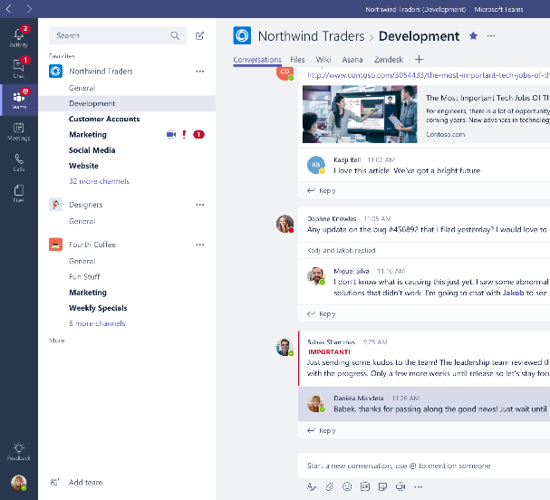
Microsoft Teams, the hub for teamwork in Office 365
Chat, calls & meetings for today’s teams
Integrated Office 365 apps
Customizable and extensible
Enterprise security, compliance & manageability
Notes:
Teams is the hub for teamwork

Slide 6
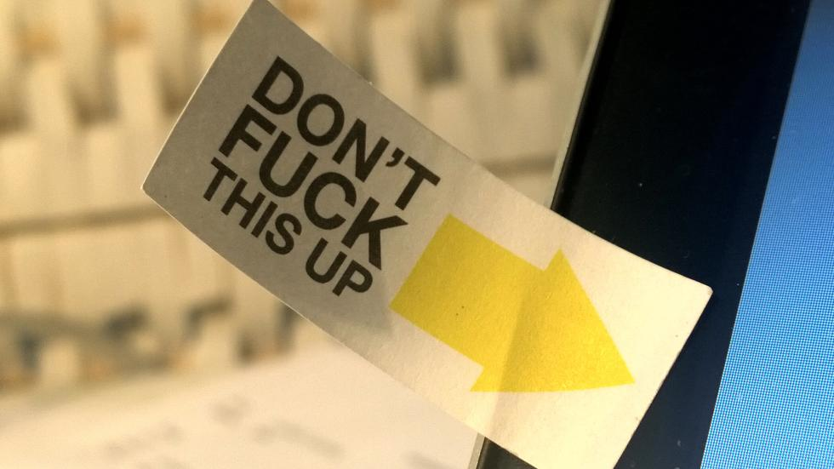
Demo
Apps in teams

Slide 7

Provisioning Microsoft Teams
Notes:
First off at this moment we got Powershell still v.093 soon 1.0
What happens first it creates a group
Then it creates a team of the group
For now only teams channels and members owners classification.
In 1,2 month or less complete team.

Slide 8



Apps are part of teamwork Bring increased productivity to your enterprise
Enable your teams can make decisions and take action faster
Reduce context switching on important tasks
Create opportunities for collaboration around external content
Notes:
Apps must be at users there fingertips
Zonder context switch en waar zit dit ook al weer

Slide 9























Unlock productivity with 150+ Teams apps
Notes:
178 apps bekent en minder bekent momenteel in de store.
popular app is dropbox which is not on this slide but you can use it

Slide 10







Microsoft Teams provides a powerful extensible platform
Tabs
Bots
Surface rich content within Teams
Help users get tasks done in conversations
Build apps with a rich set of capabilities to reach your users in their chats, channels, notifications, and personal workspace.
Compose Extensions
Connectors
Allow users to query and share rich cards in conversations
Post rich updates to channels
Actionable Messaging
Activity Feed
Add rich interaction to your connector cards
Engage users via feed notifications
Microsoft Graph
Outgoing webhooks
Build in intelligence and connect to data that drives productivity
Help users get tasks done in conversations without bot framework

Slide 11
What is a app
1
2
3
4
Define your app
Implement capabilities
Test your app
Distribute your app
Create the app manifest
Specify capabilities
Implement bot, tab, etc.
Leverage Teams SDKs
Host your web or service application
Create your app package
Side load to any team
Upload your package
Enable your app for your organization’s employees
Almost there (jul 2018)
Notes:
When we start app development for teams I advice to use these steps
SDKS in multiple languages
Most objvious choose nodejs
Sideload to test but we can use different ways
4 will come as sap

Slide 12
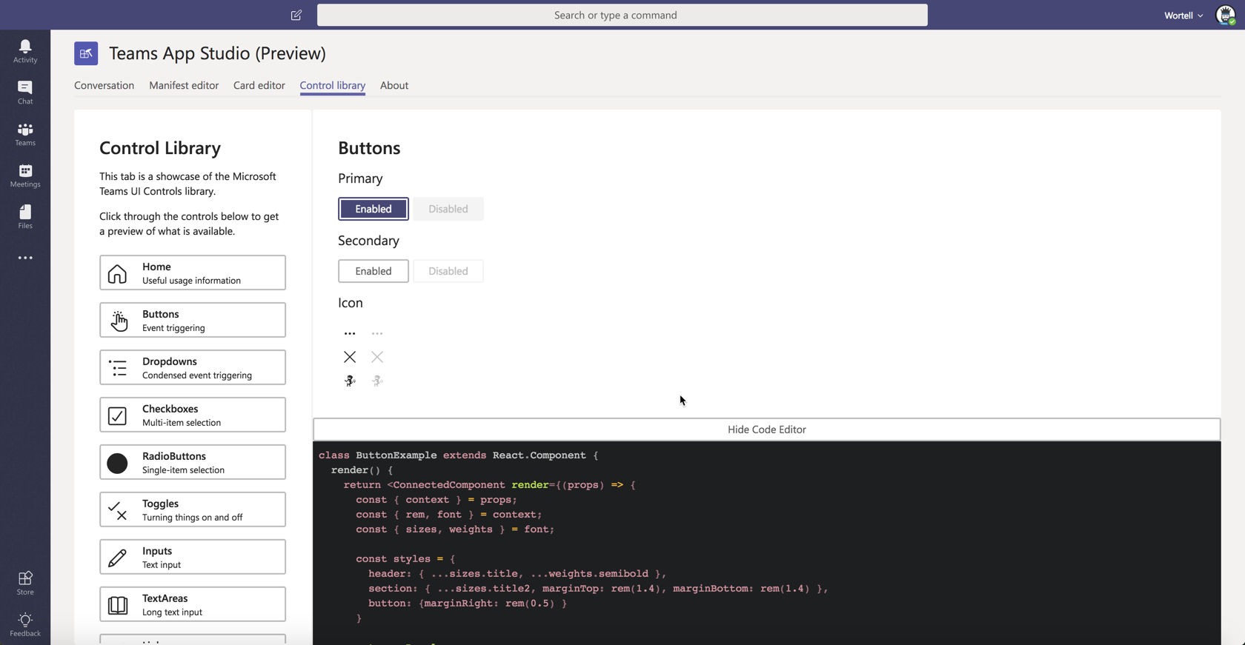
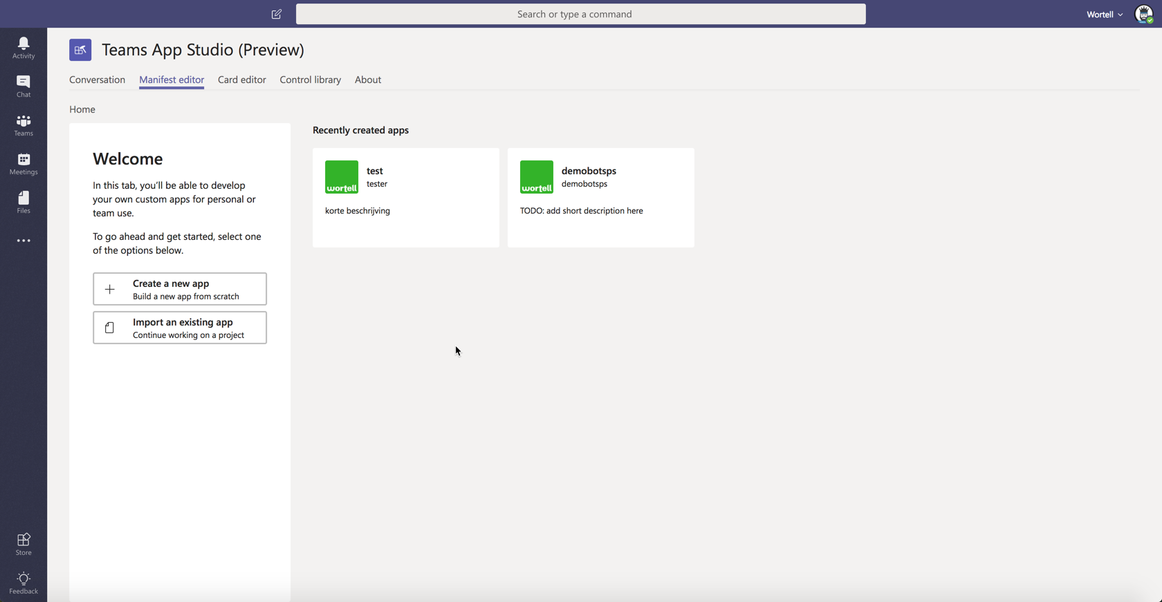
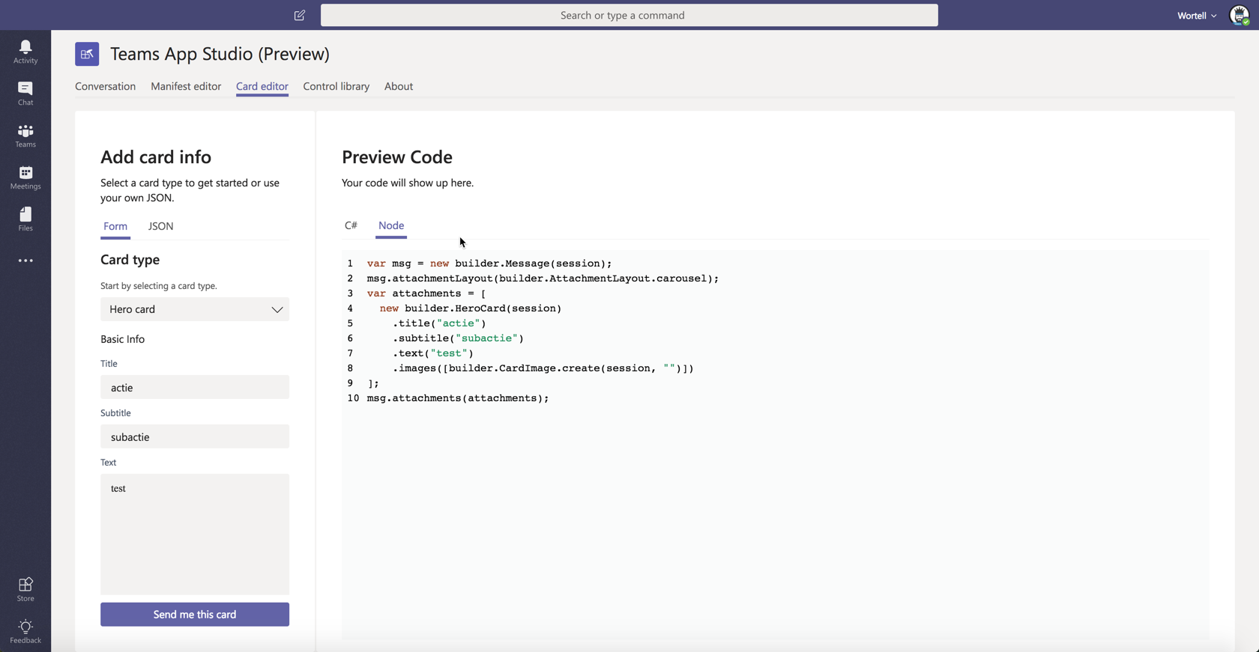
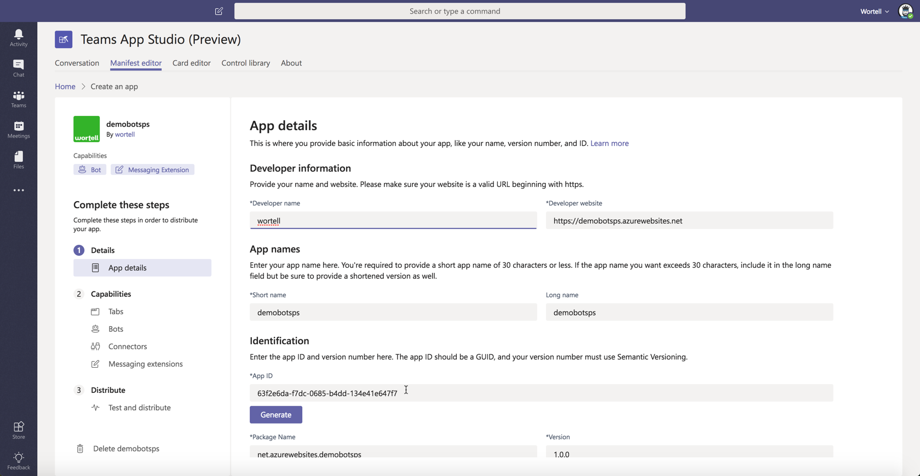
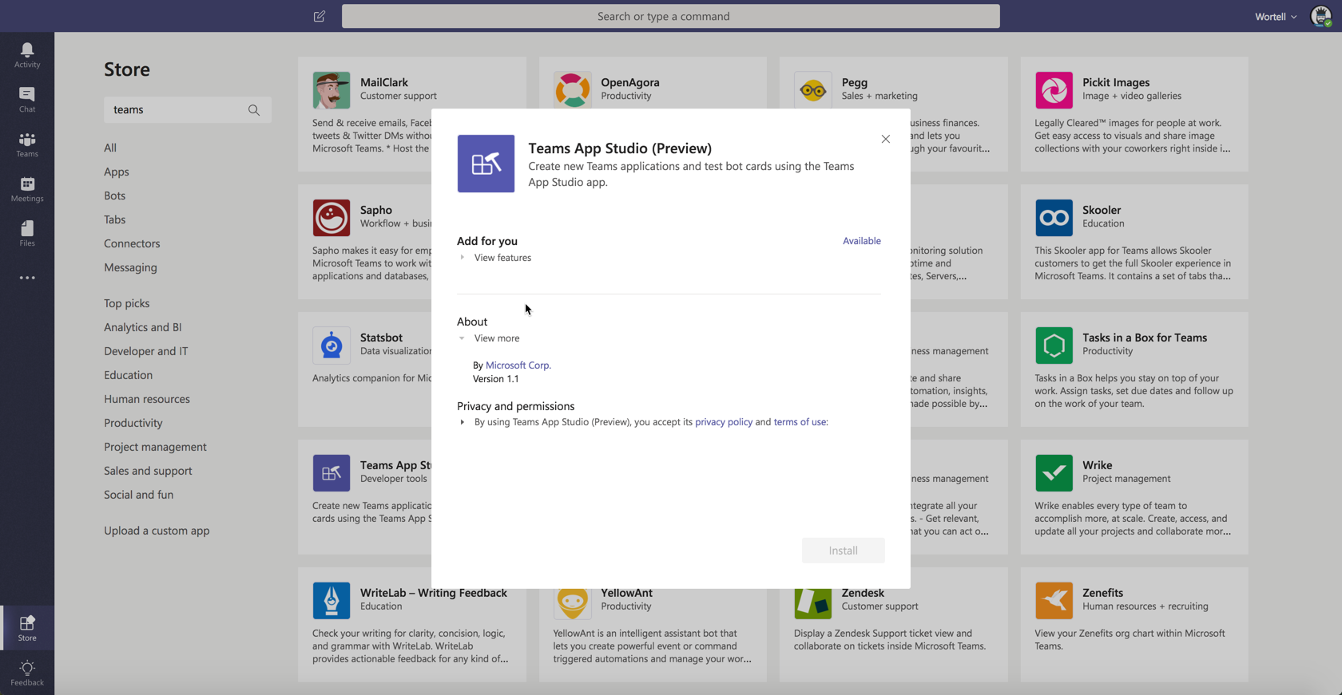
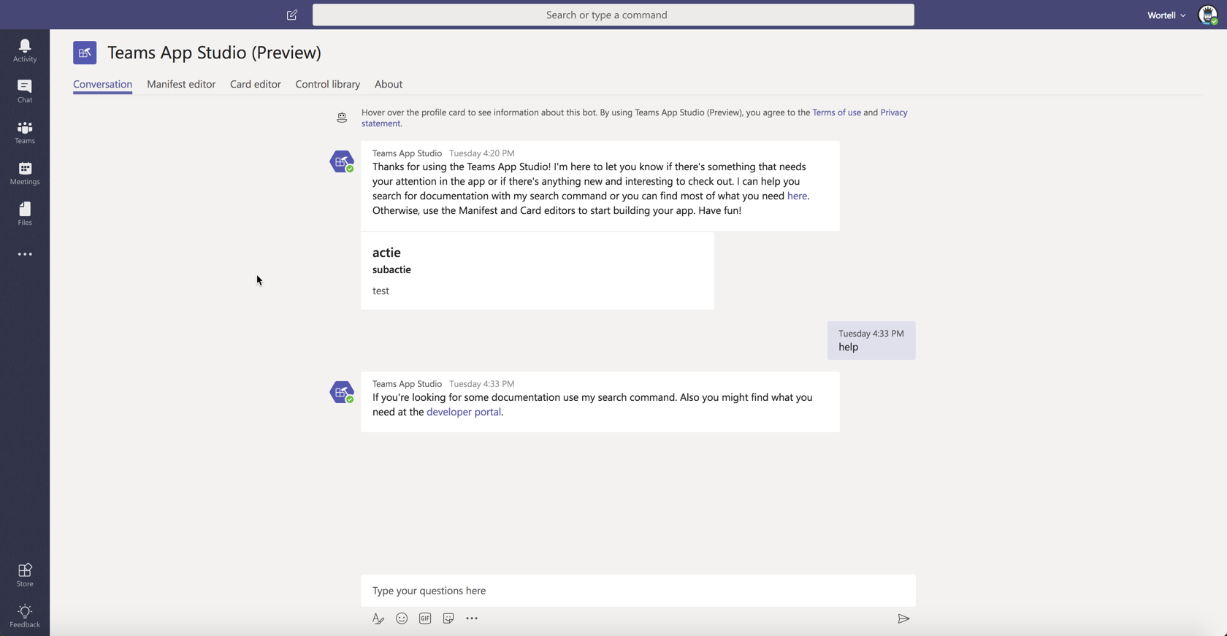
Microsoft Teams App Studio
Notes:
2 ways to start

Slide 13








Tools to use
Visual Studio Code
Node JS
Webpack
Yeoman
Typescript
Gulp
NPM package Generator-Teams
ngrok

Slide 14

So, lets have a look at what a tab is!

Slide 15







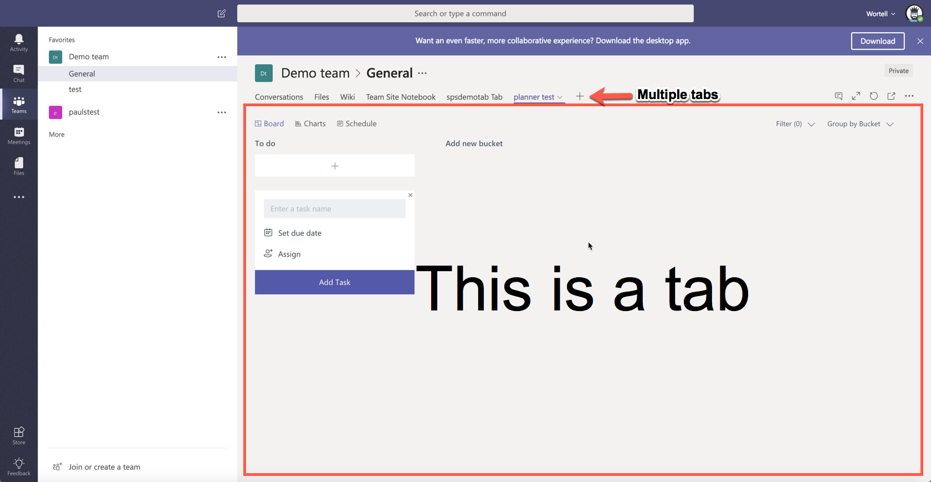
Tabs
Rich surface area for your LOB app
As simple as embedding your existing web app
Team and personal productivity
Notes:
LOB like SharePoint, planner your external website
travel sheet
Personal only for you as a user
Some best practices creating a tab
1. make it easy for users to access what they need
2. Don’t create a tab which has total different view
3. power users should use your full app)
4. focus on what you want the user to do

Slide 16
Tabs
Channel Tabs
Personal Tabs
Allow the user to configure the view based on the channel context
Content should be the same for all users – leverage collaboration
Avoid navigational dead-ends
Content should be relevant for a personal view of the experience, e.g. dashboard or aggregation across workspaces
Notes:
LOB like SharePoint, planner your external website
travel sheet
Personal only for you as a user
Some best practices creating a tab
1. make it easy for users to access what they need
2. Don’t create a tab which has total different view
3. power users should use your full app)
4. focus on what you want the user to do

Slide 17

Demo how to create a tab in Teams
Notes:
Start met Azure om een website op te zetten
Daarna yo teams
Open de app laat zien dat je al wat hebt voorbereid en wat wijzigingen
Laat het manifest zien en de scopes..personal, team.
Wat hebben we gezien

Slide 18
Tabs
Minimize context switching
Use the collaborative nature of the product
Design for bite-size tasks
Minimize extra chrome
Notes:
Some best practices creating a tab
1. make it easy for users to access what they need
2. Don’t create a tab which has total different view
3. power users should use your full app)
4. focus on what you want the user to do

Slide 19

So, lets have a look at what a bot is!

Slide 20


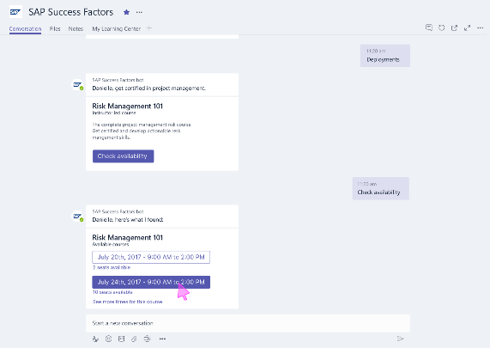
Bots
Bots make it easy for users to interact with your app in Team conversations or 1:1
Built using Microsoft Bot Framework
Complete tasks via basic commands, menu or natural language
Notes:
Example: time and absence entry and reporting
New cards to interact with
Date picker
Dropdownbox
Textbox

Slide 21
Bots – Building a great experience
Whether used as a CLI for your SaaS, or to manage workflows, create the experience that makes the most sense for your end users
Use context to provide the appropriate functionality in channel vs. 1:1 chat
Use the Bot Framework and Microsoft Teams SDKs to easily consume APIs
Use the input menu to keep your end users “on rails”
Notes:
Create value in context
Conversation of a web to a tekst is different so is it valuable

Slide 22

Demo How to create a bot in Teams

Slide 23

So, lets have a look at what a compose extension is!

Slide 24
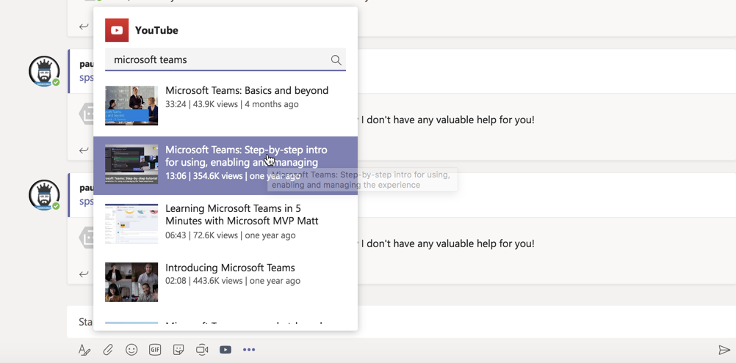
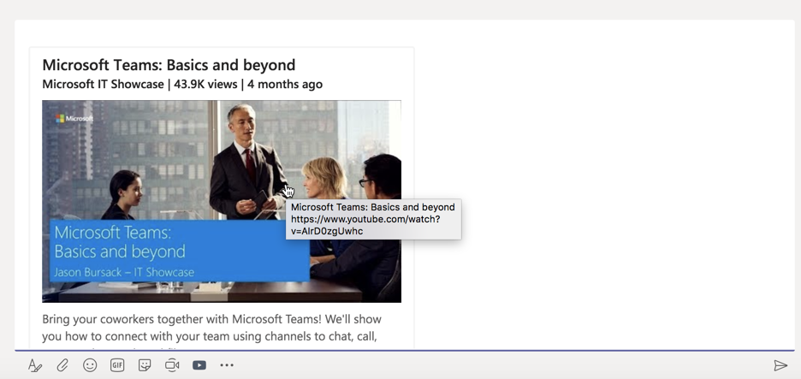
Compose Extensions
Notes:
Personalize Teams Compose box with your App & Services content
Users can query and insert your app content into conversations

Slide 25






Compose – Building a great experience
Share content that makes sense in conversations
Take advantage of the rich card types
Optimize search results to keep it snappy and responsive
Leverage Teams SDKs to easily add to your core Bot offering
Notes:
Example: time and absence entry and reporting
New cards to interact with
Date picker
Dropdownbox
Textbox
Whether used as a CLI for your SaaS, or to manage workflows, create the experience that makes the most sense for your end users
Use context to provide the appropriate functionality in channel vs. 1:1 chat
Use the Bot Framework and Microsoft Teams SDKs to easily consume APIs
Use the input menu to keep your end users “on rails”

Slide 26

So, lets have a look at what a Connector is!

Slide 27





Push rich interactive cards into channels Users can take quick actions like comment, select options, set a date Fully supported in both Teams and Outlook
Notifications and connectors

Slide 28

Demo Building a connector with flow

Slide 29
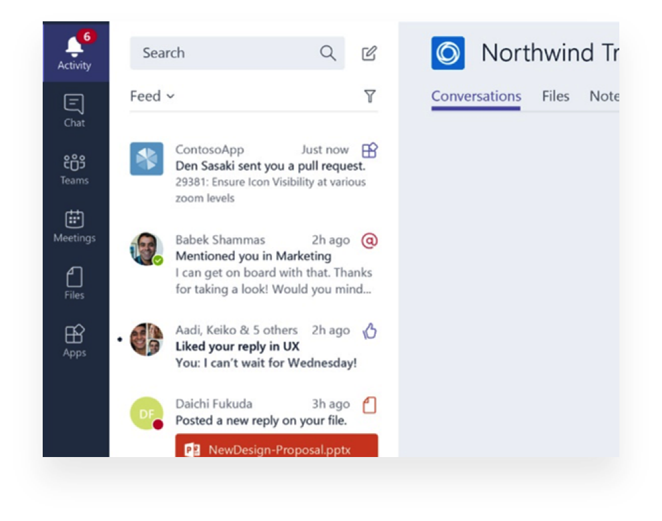



Notify users personally via the activity feed Same API as sending bot messages Deep link straight into tabs
Activity feed
Notes:
Example: new approval request
activtyfeed Aggreagation accross teams

Slide 30

Integrate with the Microsoft Graph in your Teams app Use existing Graph APIs like emails, documents, and calendar Teams-specific APIs available today in Beta with more coming soon -List of teams -List of channels -Create a channel
Microsoft Graph

Slide 31


Putting it all together: build a great Teams app
Channel Tabs Sharing group information Pin information or tools important for the channel | Connectors Simple webhook notifications in channels In and outgoing | Bots in channels Coordinate tasks in a team environment Broadly share information
Compose Extensions Make it easy for your users to look up and share information | Personal Tabs Create a personal workspace Aggregate content from across Teams | Bots in 1:1 chat Easy access to commands Q&A Provide user right insight at right time

Slide 32

What if I don’t want app “X” to be available to my end users?

Slide 33

App-level control via the O365 Portal
Manage which 3rd-party apps are available to your employees
Gives you control over if and how data leaves your organization
Two policies that can be applied
Enable all apps except for a disallowed set
Disable all apps except for an allowed set
Teams takes care of providing a graceful user experience when apps are disabled
Notes:
Admin center teams verplaats binnenkort

Slide 34

What is coming in the next weeks/months
Adaptive cards
SharePoint integration with SPFX(no Iframe)
1:1 chat with documents(bot)
Provisioning
Api version 1.0
Archiving
Backup/Restore
Distribution through you organisation
Notes:
Adaptive cards in Teams
Build smart productivity apps with Microsoft Graph JavaScript SDK
Learn how to use the Microsoft Graph PHP SDK to build you next integration with Office 365
Develop apps using the App Studio for Microsoft Teams
Authentication in Apps for Microsoft Teams
Connect to SharePoint with Microsoft Graph
Write, package and distribute apps to just your organization with the LOB app distribution support in teams
https://dev.office.com/blogs/microsoft-teams-developer-platform-enhancements-announced-for-build-2018

Slide 35

Thank you please give feedback to me.

Slide 36
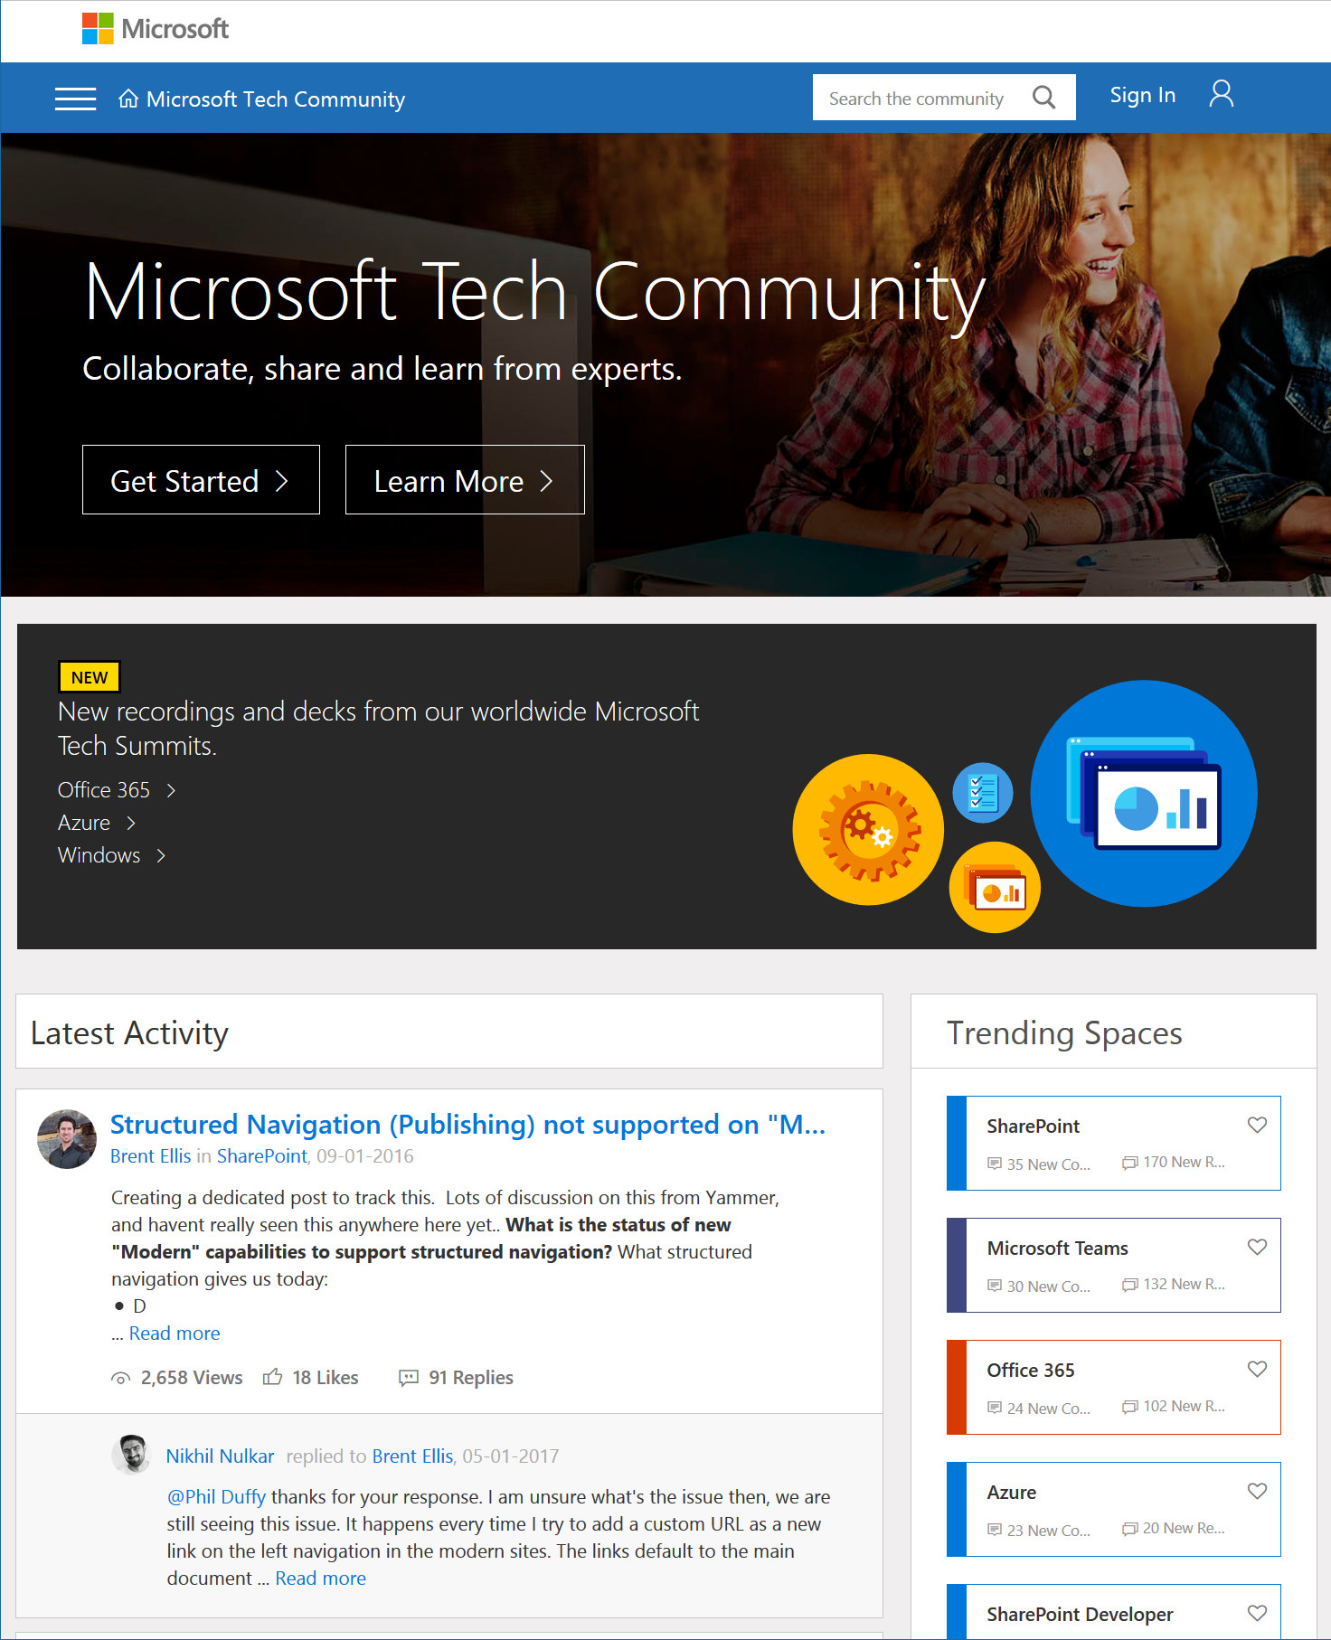
Microsoft Tech Community
techcommunity.microsoft.com
One Microsoft community for IT Pros and tech enthusiasts to learn from experts on Microsoft products
Trusted resource for news, best practices and answers from Microsoft product teams and MVPs
Join today! It’s free – sign in with your Microsoft Account.

Slide 37
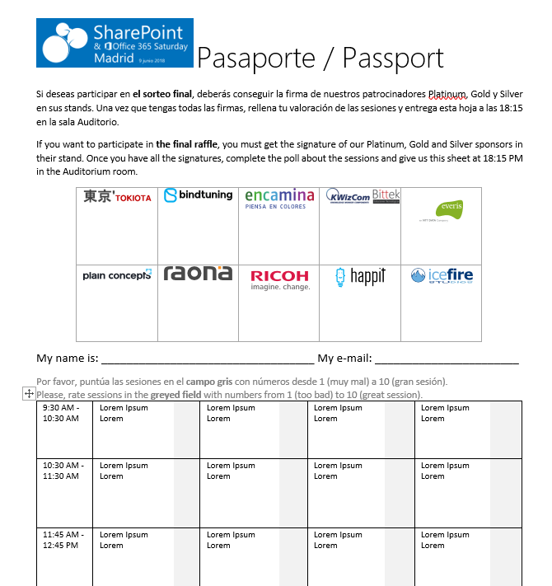







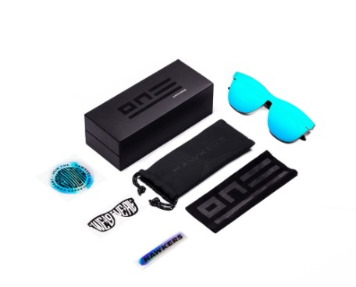







Raffle
Please, fill your SP & Office 365 Saturday Madrid passport if you want to participate.
You can win one of these gifts:
Please, fill your SP & Office 365 Saturday Madrid passport if you want to participate.
You can win one of these gifts:
Odor
Odor@winterfell.com
10
9
2x
2x
8

Slide 38
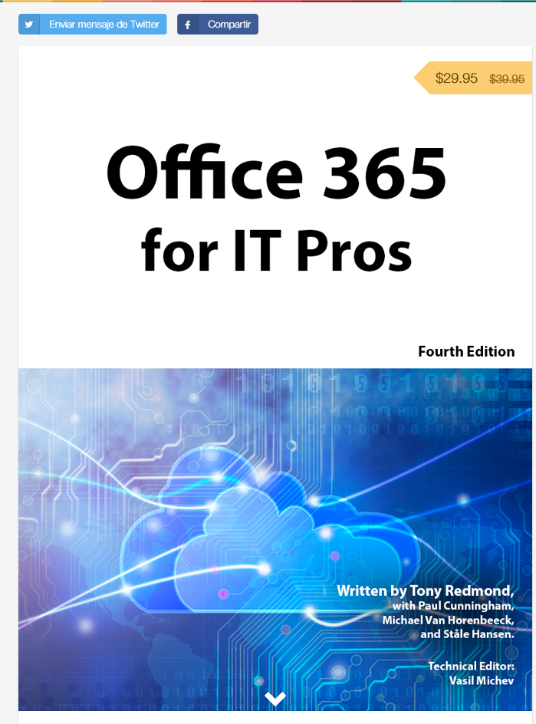
Office 365 for IT Pros
Get a discount of $10 buying the book here: https://gumroad.com/l/O365IT/spsspain

Slide 39
Notes:
This slide is mandatory. Please do not remove and try to use it during Q&A at the end of your session. Thank you!

